Slide 1
Midterm test 1-

Slide 2
Which of the following component is a part of DBMS?
Query processor : yes
Database manager: yes
Database no
File manager yes
Dml preprocessor yes
Ddl compiler yes
Catalog manager yes
User-application interface no

Slide 3
What are the tiers of the three tier client server architecture and their tasks?
First tier – client – tasks – user interface
Second tier – application server – tasks – business logic, data processing logic
Third tier – database server – tasks – data validation, database access
------
Two attributes of a relation must have different domains FALSE
An attribute of one relation and an attribute fo antoher relation may have the same domains TRUE

Slide 4
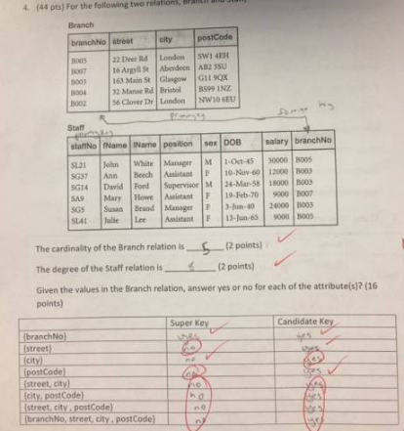
yes | Yes
yes | Yes
No | No
Yes | Yes
Yes | No
Yes | No
Yes | No
Yes | No

Slide 5
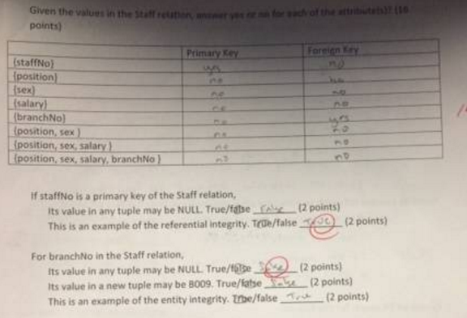
False
True

Slide 6
List the names of the three main phases of the database design:
Conceptual, logical, physical
Which phase does each of the following activities belong?
Constructing an ER model – conceptual
Performing normalization – logical
Designing file organizations and indexes - physical

